Slide 1
Team 1 Datathon Presentation
Team Members:
Akash
Alec Alejandro
Himanshu

Slide 2
Flowchart of Analysis
Objective
Data Curation
Pre-Processing
Modelling
Insights
Objective: Developing a predictive modelling tool to forecast demand of fuel-oils using time-series models
Data Curation
Modelling
Brainstorming
Need for prediction
Aggregating by month
Merge data from different sources
Inferences
Business decisions
Prospective Features
Data Mining
Exploring different models
Hyper-tuning optimal model
Objective
Pre-Processing
Insights

Slide 3


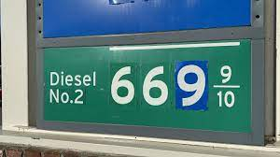

Distillate Fuel Oil Variables
Objective
Data Curation
Pre-Processing
Modelling
Insights
US Truck Sales
US Distillate Fuel Oil Stocks (barrels)
US Diesel Fuel Prices
US Distillate Fuel Oil Net Production

Slide 4

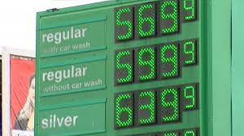
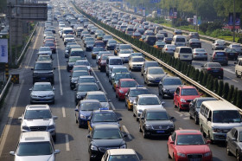
Finished Motor Gasoline Datasets and Variables
Objective
Data Curation
Pre-Processing
Modelling
Insights
US Light Weight Vehicle Sales
US Finished Motor Gasoline Stocks (barrels)
US Finished Motor Gasoline Prices
US Finished Motor Gasoline Net Production
US Light Weight Vehicle Miles Driven

Slide 5


Kerosene-Type Jet Fuel Datasets and Variables
Objective
Data Curation
Pre-Processing
Modelling
Insights
US Revenue Aircraft Miles (Cargo + Passenger Flights)
US Kerosene-Type Jet Fuel Stocks (barrels)
US Kerosene-Type Jet Fuel Spot FOB Prices
US Kerosene-Type Jet Fuel Net Production

Slide 6
Data Pre-Processing
Objective
Data Curation
Pre-Processing
Modelling
Insights
Stocks
Month | Jet Fuel Demand | Net Production | Stocks | Revenue | Spot Price
01-2012 | 1342.25 | 41216 | 41852.00 | 615414 | 3.087200
01-2013 | 1354.25 | 40598 | 39922.25 | 614477 | 3.091095
01-2014 | 1453.40 | 43198 | 37257.80 | 602506 | 2.920905
01-2015 | 1506.40 | 45585 | 37394.80 | 619217 | 1.495550
01-2016 | 1575.20 | 46936 | 41445.00 | 632006 | 0.928105
... | ... | ... | ... | ... | ...
12-2017 | 1871.60 | 53098 | 40296.00 | 697182 | 1.816500
12-2018 | 1621.00 | 55530 | 39996.75 | 718835 | 1.711944
12-2019 | 1786.75 | 55460 | 39104.75 | 748684 | 1.889381
12-2020 | 1217.75 | 32774 | 36326.75 | 480867 | 1.323818
12-2021 | 1468.80 | 45014 | 35454.60 | 670477 | 2.095227
Spot Price
Net Production
Merged Data
Revenue
Jet Fuel Demand
Month
Month
Group Weeks by Month

Slide 7
Data Validation Set
Include MAPE from data validation set

Slide 8
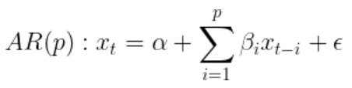
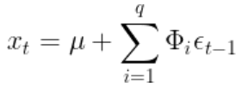
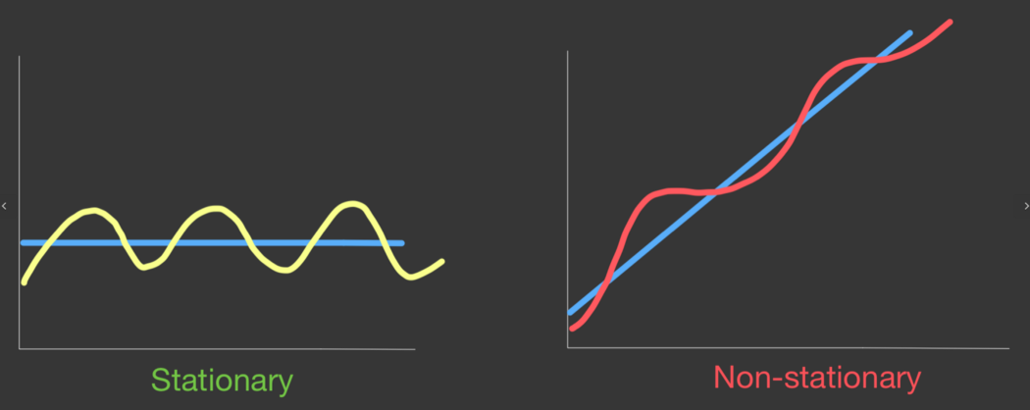
Modelling
Objective
Data Curation
Pre-Processing
Modelling
Insights
ARIMA – Auto Regressive Integrated Moving Average
“p” determines the number of past values p will be
taken into account for the prediction
Auto Regressive “p”
AR I MA
Moving-average MA model depends on past
forecast errors to make predictions
Achieve stationarity by taking the
difference between successive rows.
Moving Average “q”
Integrated “d”

Slide 9
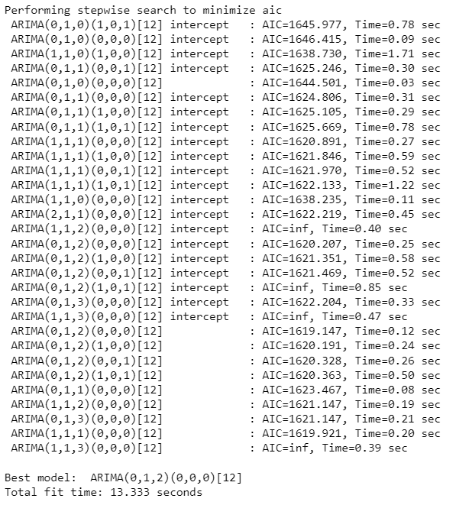

Modelling
Objective
Data Curation
Pre-Processing
Modelling
Insights
ARIMA – Auto Regressive Integrated Moving Average
Python
Finding Optimal Parameters that minimize AIC
Plug values into Alteryx ARIMA model

Slide 10
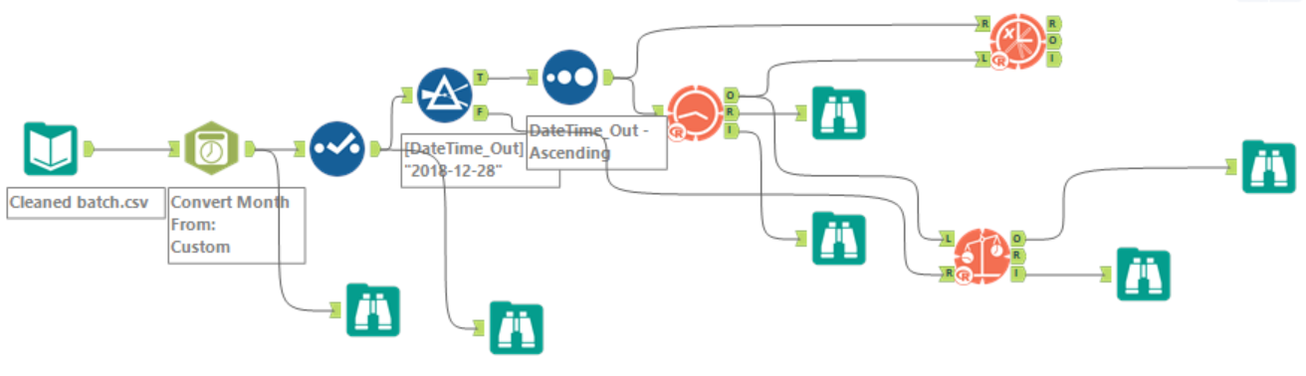
Modelling
Objective
Data Curation
Pre-Processing
Modelling
Insights
ARIMA – Auto Regressive Integrated Moving Average

Slide 11
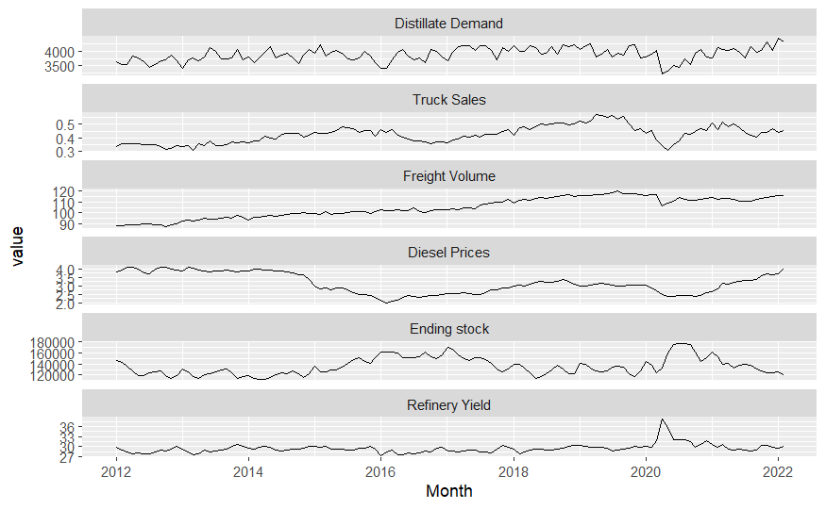
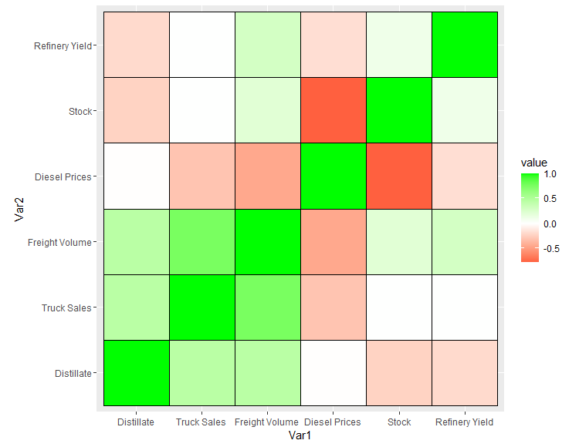
Distillate Fuel Oil Insights
Objective
Data Curation
Pre-Processing
Modelling
Insights

Slide 12
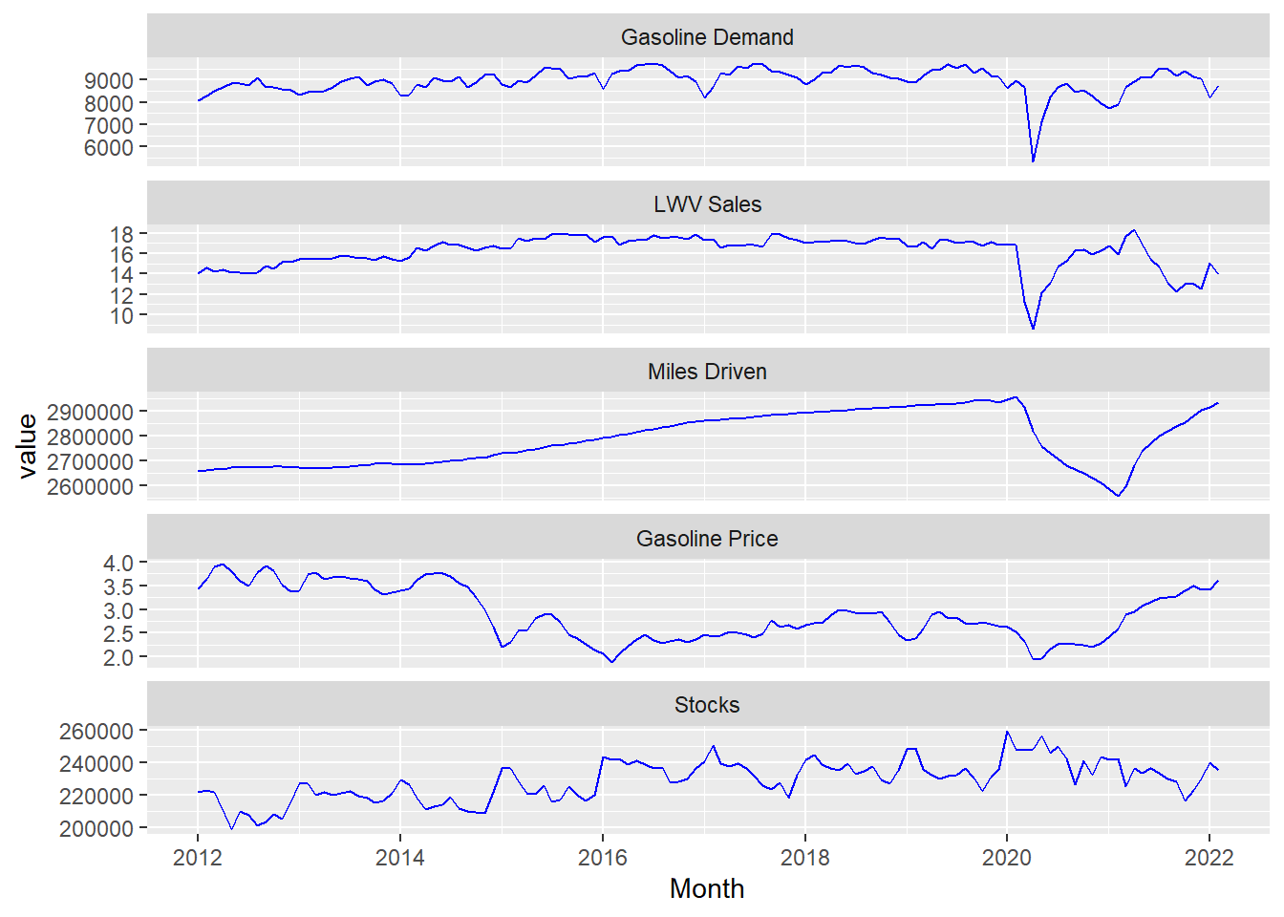
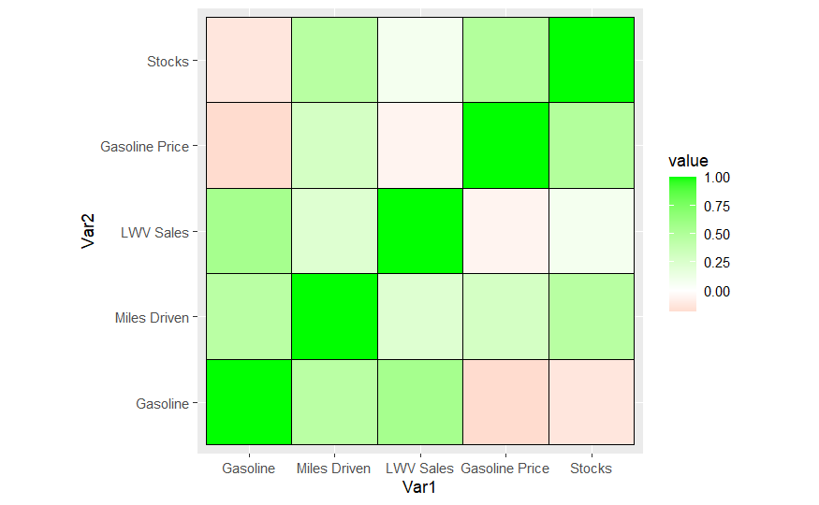
Finished Motor Gasoline Insights
Objective
Data Curation
Pre-Processing
Modelling
Insights

Slide 13
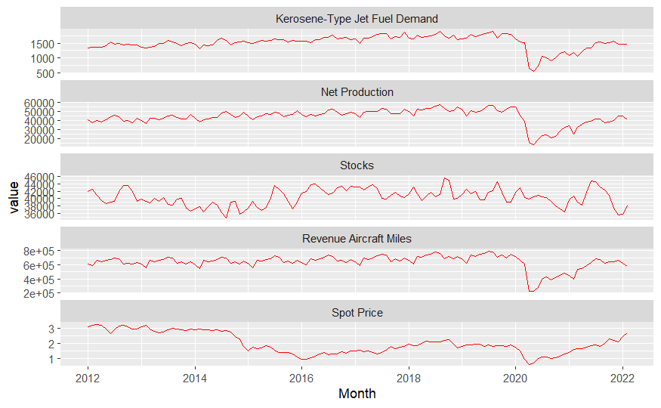
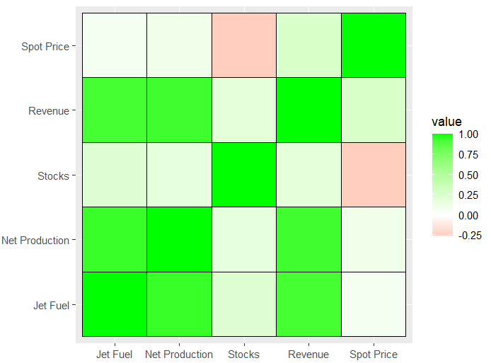
Kerosene-Type Jet Fuel Insights
Objective
Data Curation
Pre-Processing
Modelling
Insights

Slide 14
Data Sources
US Distillate Fuel Stocks (barrels): https://www.eia.gov/dnav/pet/hist/LeafHandler.ashx?n=PET&s=WDISTUS1&f=W
US Diesel Fuel Prices: https://www.eia.gov/dnav/pet/hist/LeafHandler.ashx?n=PET&s=EMD_EPD2D_PTE_NUS_DPG&f=M
US Distillate Fuel Net Production: https://www.eia.gov/dnav/pet/PET_PNP_WPRODRB_A_EPD0_YPR_MBBLPD_W.htm
US Truck Sales: https://fred.stlouisfed.org/series/HTRUCKSSAAR
–
US Finished Motor Gasoline Stocks (barrels): https://www.eia.gov/dnav/pet/PET_STOC_TYP_C_NUS_EPM0F_MBBL_M.htm
US Finished Motor Gasoline Prices: https://www.eia.gov/dnav/pet/PET_PRI_GND_DCUS_NUS_M.htm
US Finished Motor Gasoline Net Production: https://www.eia.gov/dnav/pet/PET_PNP_WPRODRB_A_EPM0F_YPT_MBBLPD_W.htm
US Light Weight Vehicle Sales: https://fred.stlouisfed.org/series/ALTSALES
US Light Weight Vehicle Miles Driven: https://fred.stlouisfed.org/series/M12MTVUSM227NFWA, https://www.bts.gov/content/us-vehicle-miles
–
US Kerosene-Type Jet Fuel Stocks (barrels): https://www.eia.gov/dnav/pet/hist/LeafHandler.ashx?n=PET&s=WKJSTUS1&f=W
US Kerosene-Type Jet Fuel Prices: https://www.eia.gov/dnav/pet/hist/eer_epjk_pf4_rgc_dpgD.htm
US Kerosene-Type Jet Fuel Net Production: https://www.eia.gov/dnav/pet/PET_PNP_WPRODRB_A_EPJK_YPR_MBBLPD_W.htm
US Revenue Aircraft Miles (Cargo + Passenger Flights): https://www.transtats.bts.gov/traffic/
-
[1]: https://www.autonews.com/retail/used-car-sales-set-us-record-2021-cox-automotive-says

Slide 15
END

Slide 16
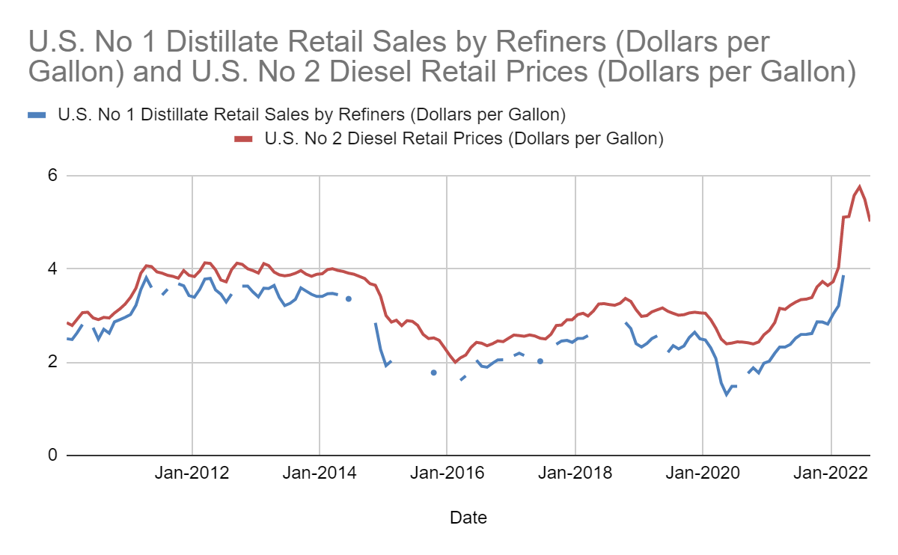
Why use Diesel Prices Instead of Distillate Prices?
There are missing data for the Distillate prices
The Diesel and Distillate prices are highly correlated.

Slide 17
Dataset and Variable Extra Information (if we have time to include)
Stocks and Production affect supply. Supply affects price, and price affects demand.
Truck sales can be used to forecast diesel use because 76% of trucks are powered by diesel engines. [1]
77% of distillate fuel is used by the transportation sector [2]
[1] https://www.dieselforum.org/trucking
[2] https://www.eia.gov/energyexplained/diesel-fuel/use-of-diesel.php#:~:text=Diesel%20fuel%20is%20used%20for,equipment%20in%20the%20United%20States.

Slide 18
Definitions
Spot Price FOB: The free on board spot price is the current price of the commodity and where the buyer has ownership of the good as soon as it leaves the warehouse.
Revenue Aircraft miles: The number of miles flown in revenue producing service
Covariate Explanation (https://www.vebuso.com/2020/10/back-to-the-future-arima-and-forecasting-with-covariates/)

